Slide 1

DDD Services

Slide 2
Different “Services”
Domain Services
Application Services
Infrastructure Services

Slide 3

Infrastructure Services
Putting a message on a bus
Writing to a file
Sending an Email

Slide 4
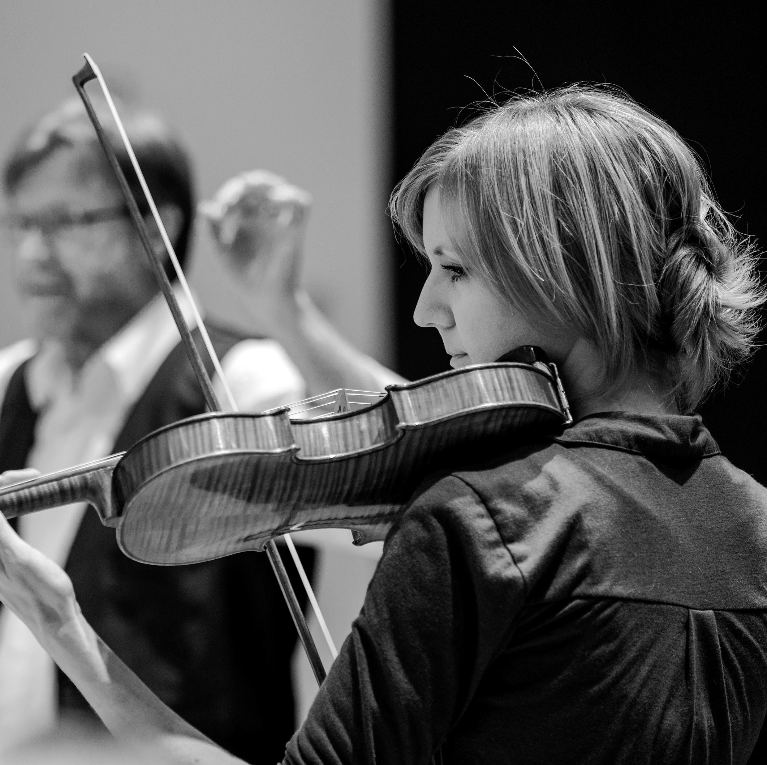
Application Services
“Orchestrates” work between your entities in your Domain
Responsible for “calling upon” your domain entities
Ex. Command Handler.

Slide 5
Domain Services
“When a significant process or transformation in the domain is not a natural responsibility of an ENTITY or VALUE OBJECT, add an operations to the model as standalone interface declared as a SERVICE.”

Slide 6
Characteristics of a “Good” Service
Not a natural part of an Entity or Value Object
Interface is defined in terms of other elements of Domain Model
Operation is Stateless

Slide 7


Domain Services
Used VERY Sparingly
Too many of these indicates poor modeling

Slide 8

Demo

